Slide 1

SCHOOLS-HUB
Final Year Project
F20-07
Najeebullah Khan(023-20-0058)
Muhammad Daud(023-20-0092)
Muhammad Umair (023-19-0026)
Project Supervisor: Dr. Ismail Mangrio

Slide 2

Agenda
Introduction
Problem Statement
Literature Review
Project Scope
Stakeholders
Project Development Methodology
Data Gathering from Schools
Structural Decomposition
System Description
Tools & Technologies
Implementation Details
Expected Outcome
Conclusion & Future Work
References

Slide 3
Introduction
The Schools-Hub project aims to develop a comprehensive platform to assist parents in selecting the best school for their children based on various criteria.
With the increasing number of educational institutions and varying standards, choosing the right school has become a complex decision for parents. Schools-Hub simplifies this process by providing a centralized information hub.

Slide 4
Problem Statement
Parents face significant difficulties in selecting the right school for their children due to a complex decision-making process and an overload of scattered information. Three primary problems include:
Expensive and Difficult
Lack of Centralized Data
Time Consuming

Slide 5
Literature Review
Based on various research articles, several key factors have been identified that significantly influence parental choice in school selection. These factors include:
Cost and Affordability: The impact of tuition fees and overall affordability on school selection.
Facilities and Infrastructure: The impact of school facilities on parental decisions.
Extracurricular Activities: The role of sports, arts, and other activities in shaping parental preferences.
Location and Accessibility: How the proximity of the school affects selection.
Reputation and Reviews: The influence of a school's reputation and parental reviews.

Slide 6
Project Scope
The proposed system will offer the following services:
Comprehensive School Profiles
Advance Filters
Ratings and Reviews System
AI Bot
Blogs

Slide 7

Stakeholders
The Stakeholders of out System are:
Parents or Guardians
Schools
Development Team
Project Supervisor
Project Committee

Slide 8
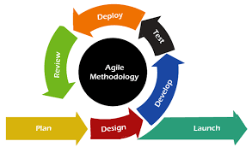
Project Development Methodology
Agile Methodology
Planning and Requirements Analysis: Conduct initial research and gather Data from schools and research articles. Design surveys for schools.
Interface Design: Create a user-friendly and engaging interface tailored to the diverse needs of users.
Development and Coding: Implement a development process using the MERN stack.
Testing: Conduct thorough testing at the end of each iteration.
Reviewing: Regularly review progress and gather feedback from stakeholders.
Launching: Launch the Platform.

Slide 9

Data Gathering from Schools
A generalized survey form was created and distributed to collect necessary information about the schools. This form included fields for details that parents typically look for when choosing a school for their child, such as:
Facilities.
Curriculum.
Faculty.
extracurricular activities.
Fee Structure.

Slide 10
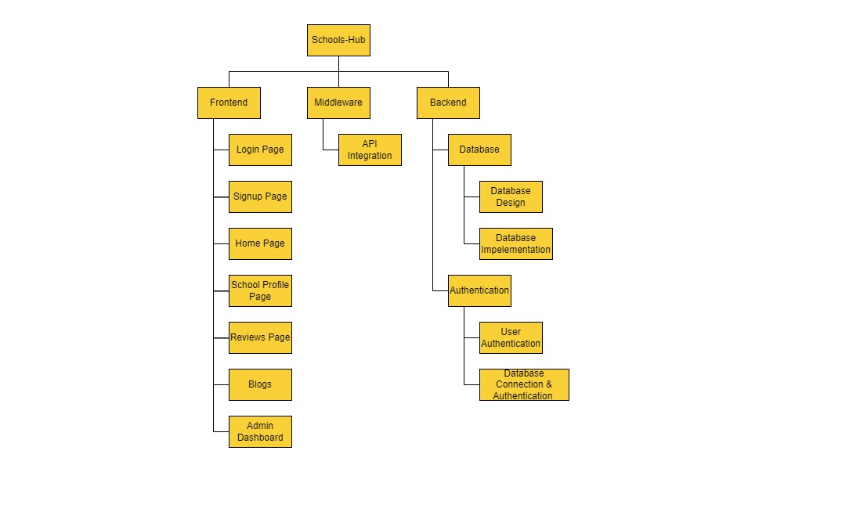
Structural Decomposition Hierarchy

Slide 11
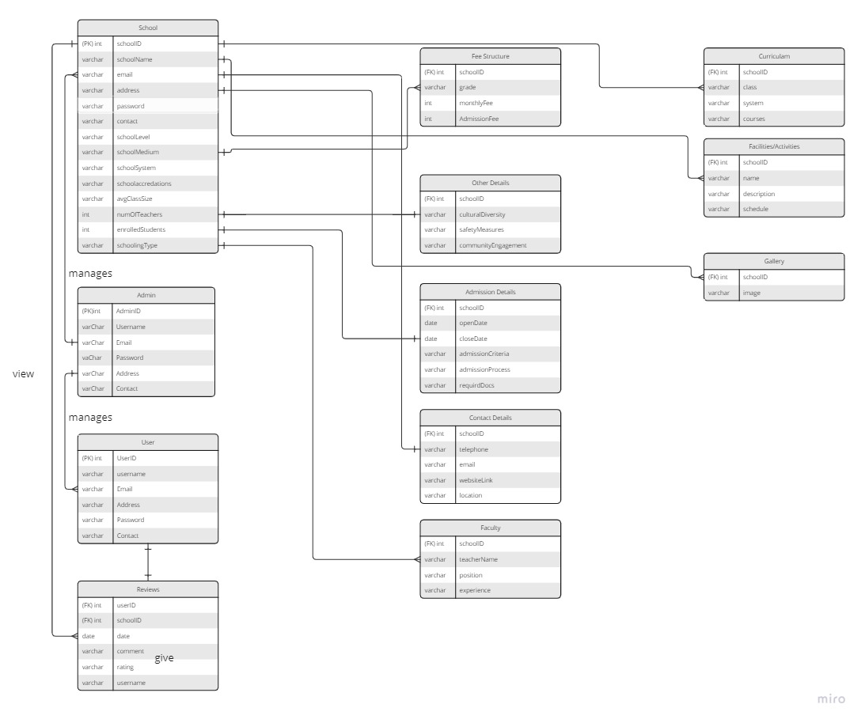
Entity Relationship Diagram

Slide 12
System Description
Assumptions
User has compatible browser.
User has internet connection.
User knows English language.
Dependencies
User dependency on the authentication and verification identity.
Response time of application may depend on internet connection.

Slide 13






Technologies Used

Slide 14


Tools

Slide 15
User Feedback
User feedback for our platform was gathered through a structured process involving a survey distributed to 10 users. The survey was designed using Google Forms and consisted of three main sections:
General Feedback on Platform Design and Interface
Feedback on Specific Features
Additional Feedback and Suggestions

Slide 16

Implementation Details
Modules |  | Status
Proposal |  | Completed
SRS And SDS |  | Completed
Backend | Frontend
No-SQL | Sign up Module | Completed
Authentication | Login Module | Completed
Database Connectivity | Home Page | Completed
 | Complete Frontend Design | Completed
 | Admin Dashboard | Completed
 | Blogs Page | Completed
 | API Integration | Completed
 | School Profile Module | Completed
 | Reviews and Rating Module | Completed
Final Report |  | Completed

Slide 17
Expected Outcomes
User:
Parents are able to create their profiles.
Parents are able to search multiple schools.
Parents can view School details of various schools at a single platform.
Parents are able leave Reviews.
Parents can read Blogs.
Parents can provide prompts to AI Bot.
Schools:
Schools can manage and update their profiles.

Slide 18
Conclusion
The platform marks a notable improvement in simplifying the school selection process for parents and guardians by providing a user-friendly interface that consolidates and compares school information effectively.
It successfully bridges the information gap between schools and parents, empowering families to make informed educational choices.​

Slide 19

Future Work
Discussion Platform.
Advanced Filter.
Job Opening Section.
Mobile App.

Slide 20
Project Demo

Slide 21
Thank you!
Do You have any Questions???

